Slide 1
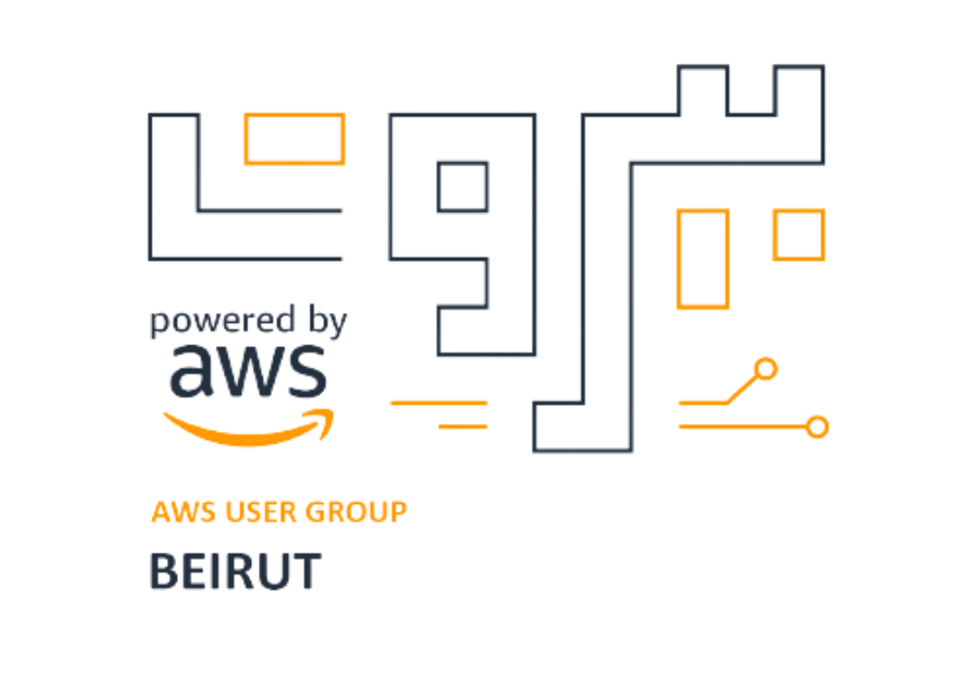
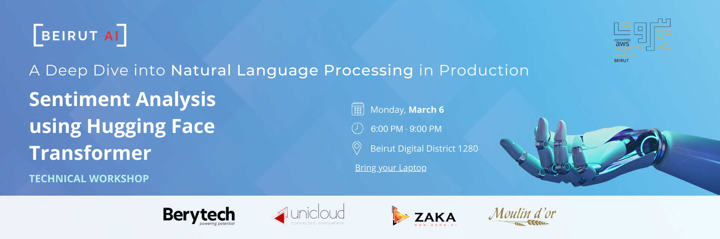
Sentiment Analysis using Hugging Face Transformer

Slide 2
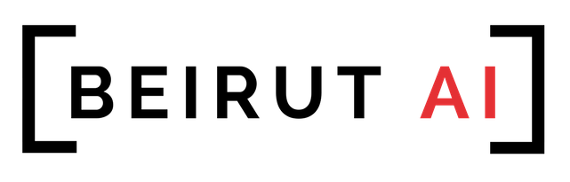
Collaboration with
x

Slide 3
Big Thank you for our sponsors

Slide 4
Big Thank you for our sponsors
donation@beirutai.org

Slide 5

Applied AI Community
ENABLING EVERYONE TO APPLY ARTIFICIAL INTELLIGENCE beirutai.org
Meetup (Technical Workshops & Talks & Panel Discussions)
Hackathons
Datathons
University Ambassadors (20) in collaboration with Zaka Ambassadors
Community Aid Program (400+)
Beirut AI Heroes
Beirut AI Membership (Mentorship Program, group discussions…)
Notes:
We are the largest applied Artificial Intelligence community in Lebanon.
Our goal is it to enable everyone to learn and apply artificial intelligence. WE WANT EVERYONE TO DISCOVER THE POSSIBILITIES OF ARTIFICIAL INTELLIGENCE AND HAVE ACCESS TO TOOLS AND KNOWLEDGE OF APPLYING IT IN different fields. Our mission is to help local startups, companies and individuals understand AI and implement it in various industries.
We do this by: 1- organizing gatherings where we bring AI practitioners to share their experience with the community.
We also host monthly technical workshops that target developers and engineers looking for a more hands-on approach.

Slide 6
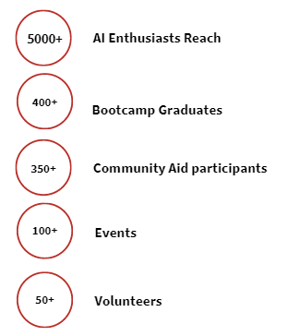
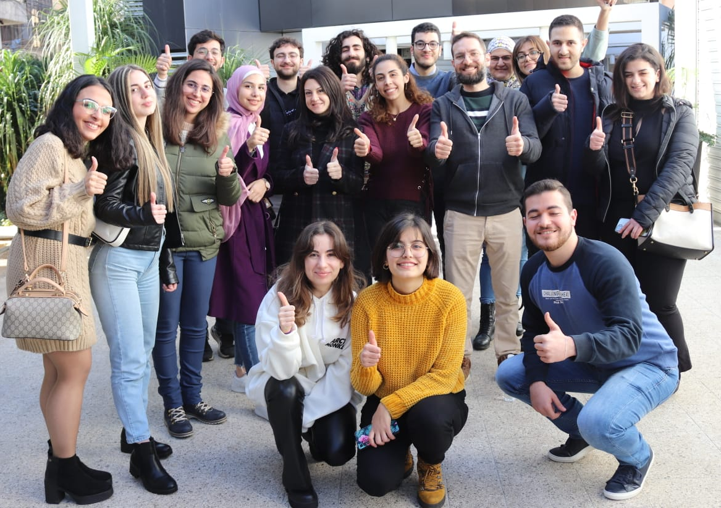
BIG THANK YOU TO OUR TEAM!

Slide 7



Let’s Have You on Board!
BeirutAI
beirutai.org
beirut.ai
BeirutAI
BeirutAI
AWS User Group Beirut
awsugbeirut
awsLebanon
AWSBeirut
Notes:
You can follow us on social media for more events. Join our membership program to connect learn contribute and grow..
Share and tag us!!

Slide 8
https://www.twitter.com/AWSBeirut
https://www.linkedin.com/groups/12148773
https://www.facebook.com/awsLebanon
https://www.instagram.com/awsugbeirut

Slide 9

Meet your Instructor
Jana Kabrit
Machine Learning Engineer and Enthusiast
AI Developer @ Assentify
Certification Instructor @ Zaka AI
Mentorship Lead @ Beirut AI

Slide 10
Introducing Beirut AI
Agenda of the day
What is AI?
AI Lifecycle
Types of AI
Applications of AI
What is NLP?
Challenges of NLP
NLP Pipelines
Transformers
Intro to Artificial Intelligence
Dive Into Natural Language
Processing
Hands-on Workshop
Notes:
Today we have a very rich schedule! We will first introduce Beirut AI, who are are, our mission and what we do.
Then we will have a short presentation to introduce Artificial Intelligence, and make sure you have the basic understanding of what AI is.
We will lay the theory background and the fundamentals of data science before moving to the hands-on coding session.
We will have a short break (5min) between the sessions.
Hope you will all enjoy our workshop.

Slide 11
What is AI?
AI: the theory and development of computer systems able to perform tasks normally requiring human intelligence, such as visual perception, speech recognition, decision-making, and translation between languages.

Slide 12
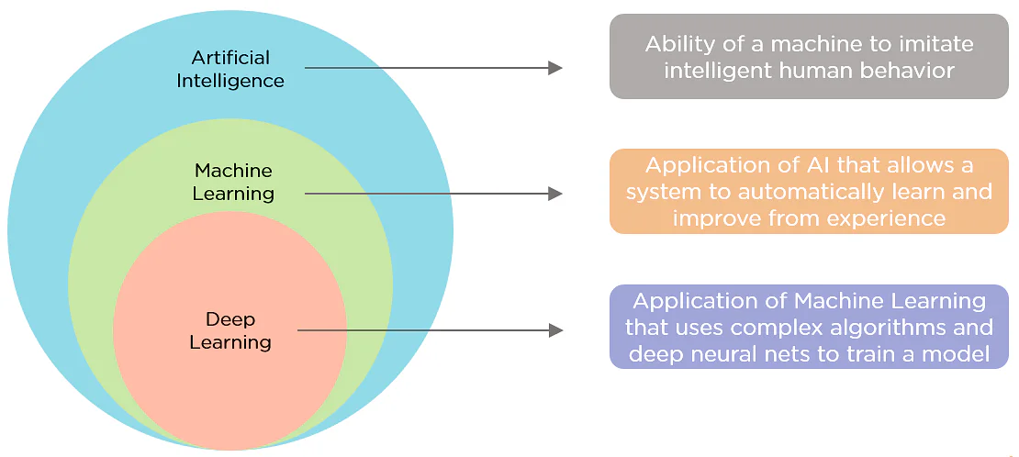
What is AI?

Slide 13
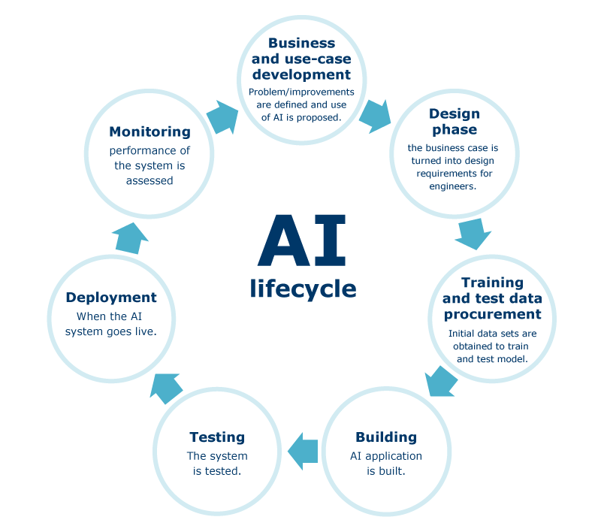
AI Lifecycle

Slide 14
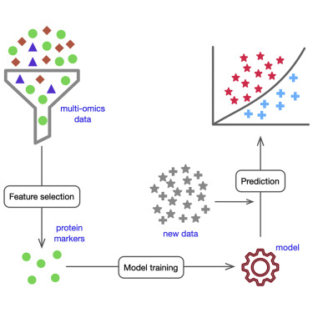
AI Lifecycle

Slide 15
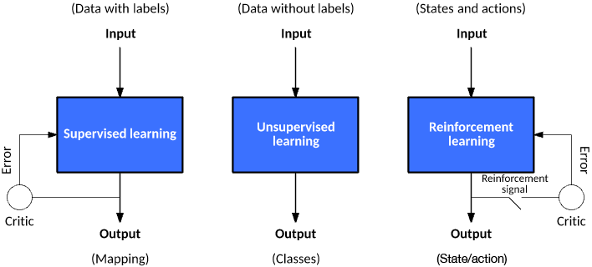
Types of AI
Inside the training:

Slide 16
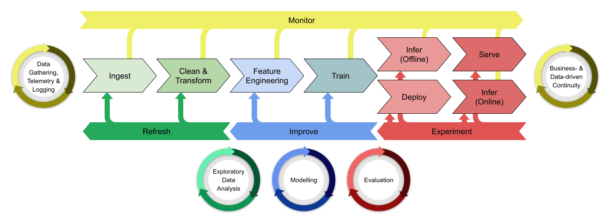
Where does AWS come in?

Slide 17
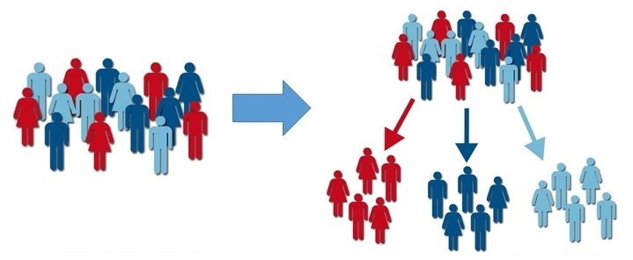
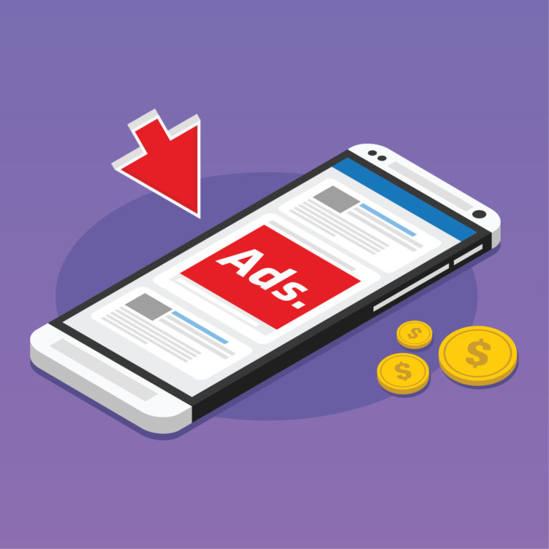
Applications of AI
Targeted Ads

Slide 18
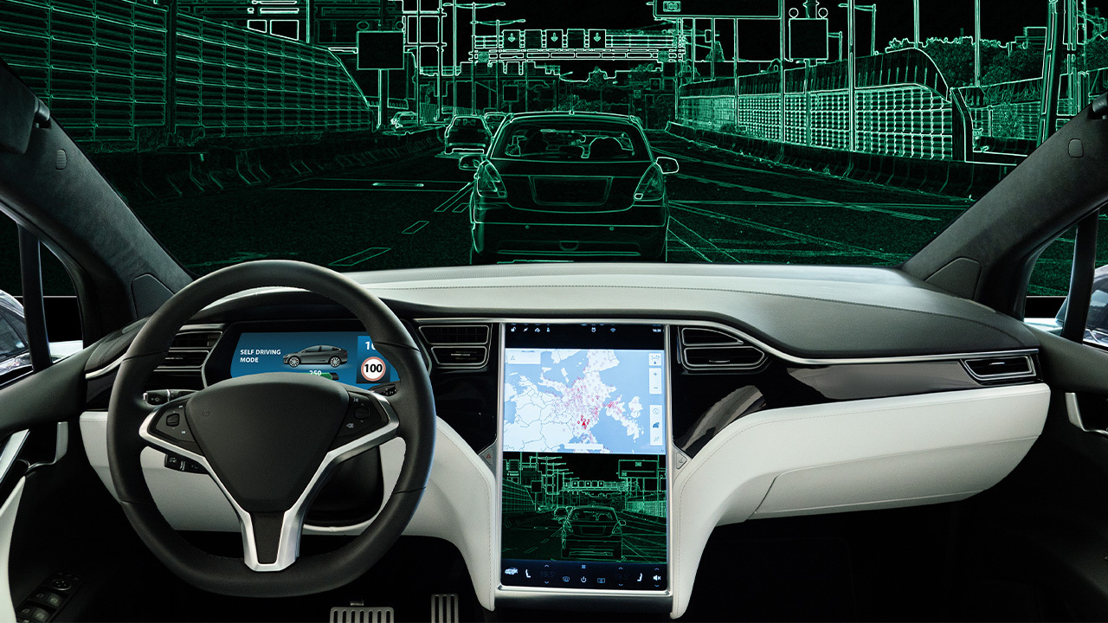
Applications of AI
2. Autonomous Vehicles

Slide 19
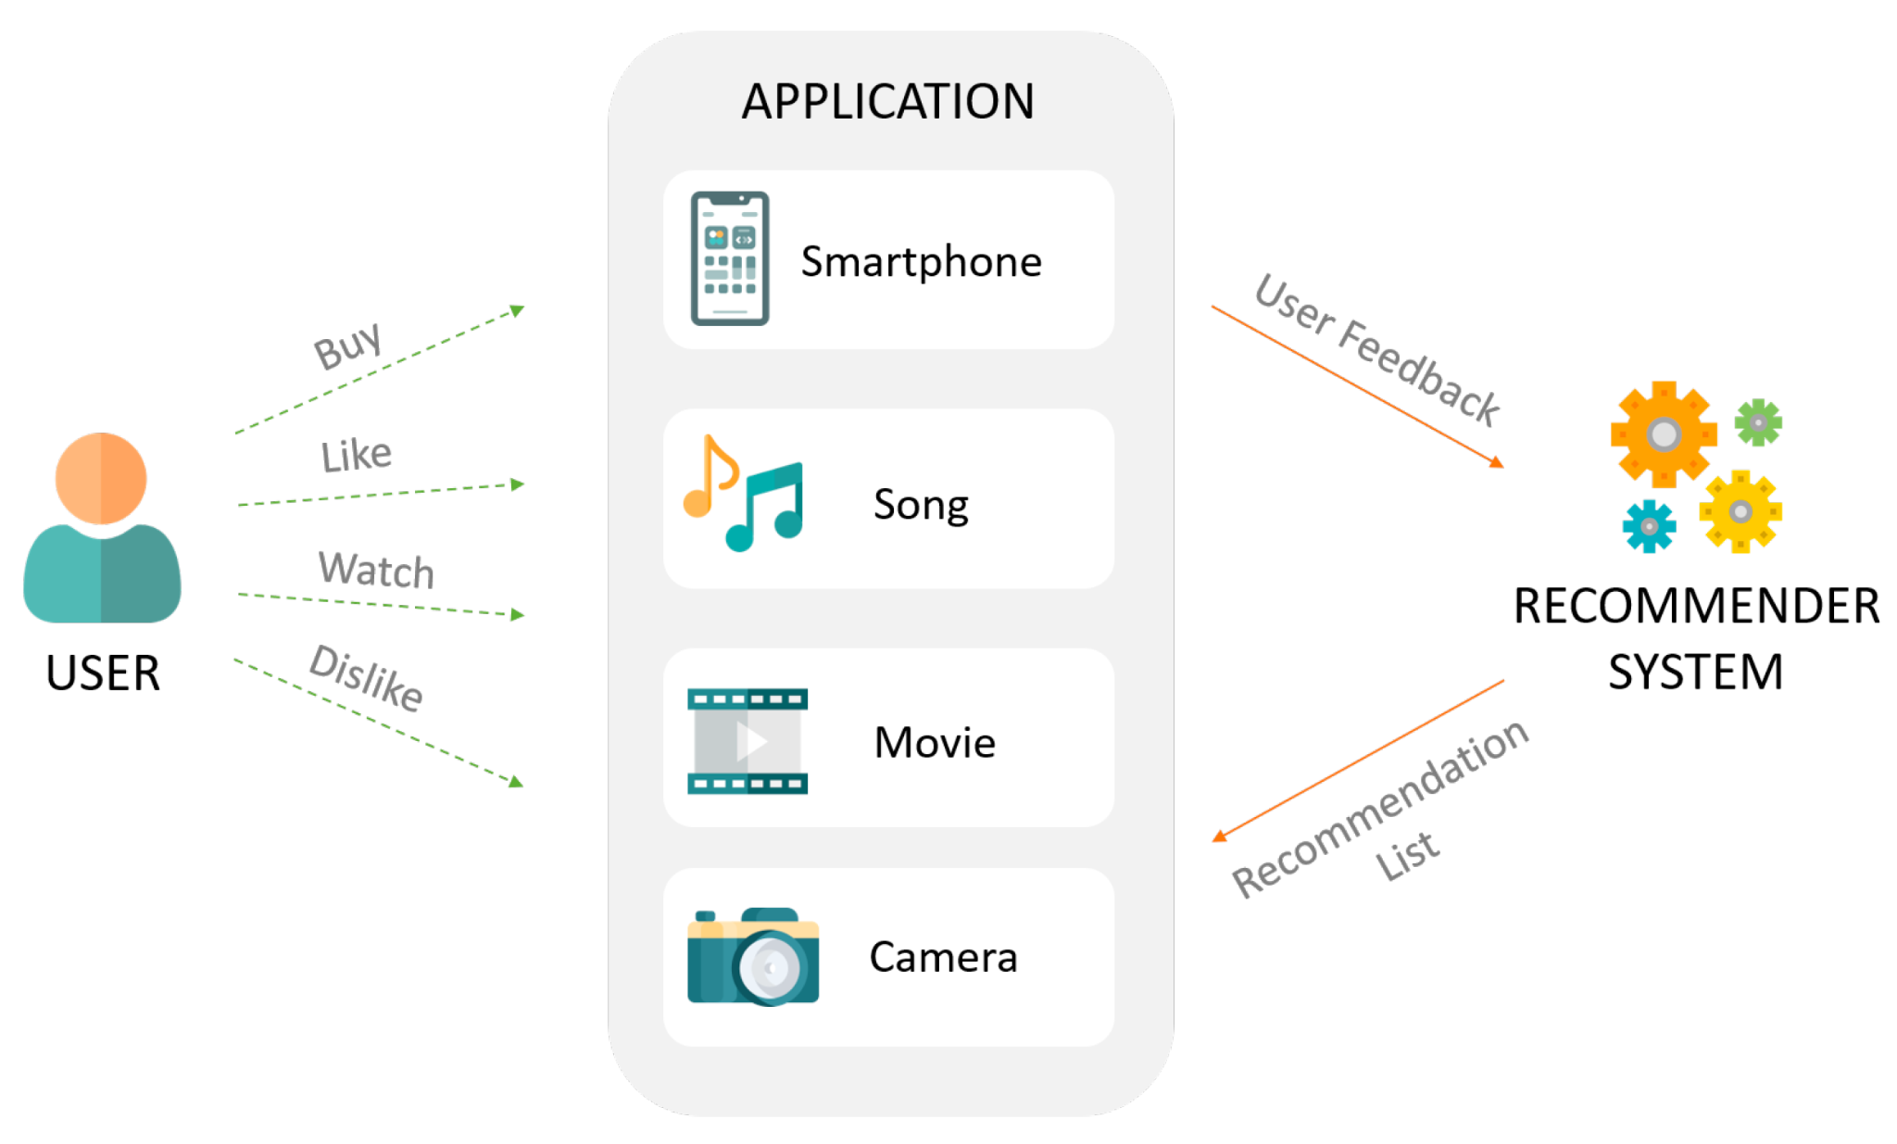
Applications of AI
3. Recommendation Systems

Slide 20

Applications of AI
4. AI in Gaming
In Red Dead Redemption 2, the behavior of NPCs and their interaction with you depend on variables like blood stains on your clothes or the type of hat that you are wearing. Since there is an enormous matrix of possibilities, the whole game world could be manipulated by your decisions. There could be extremely complicated cause-and-effect relationships.

Slide 21
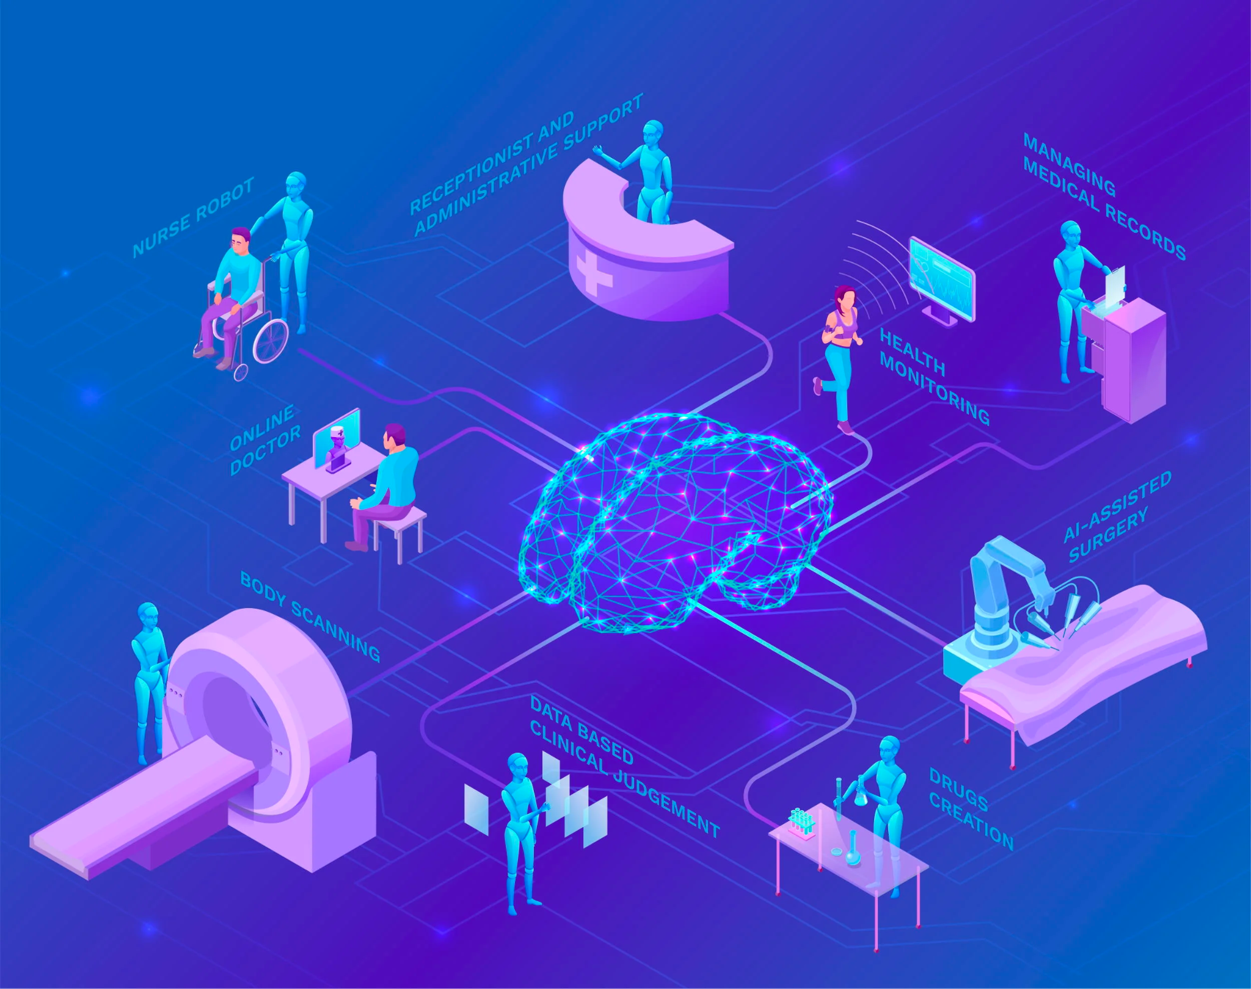
Applications of AI
5. AI in Healthcare
AI can be used to help detect diseases faster, provide personalized treatment plans and even automate certain processes such as drug discovery or diagnostics.

Slide 22


What is NLP?
Before that, let us see what is Natural Language?
Messages, Articles, Papers, Books,... Written Word
Voice Notes, Dialogues, ... Spoken Word

Slide 23
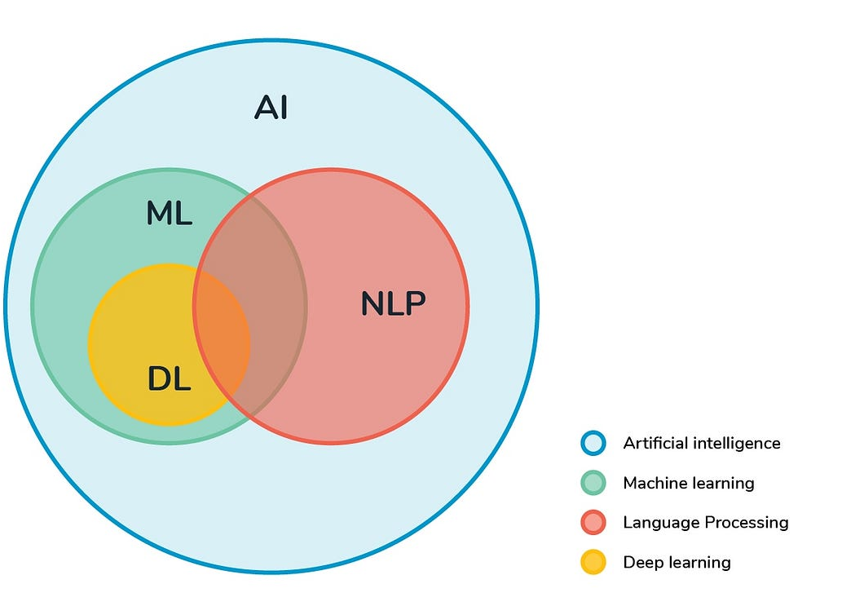
What is NLP?
the ability of a computer program to understand human language as it is spoken and written

Slide 24


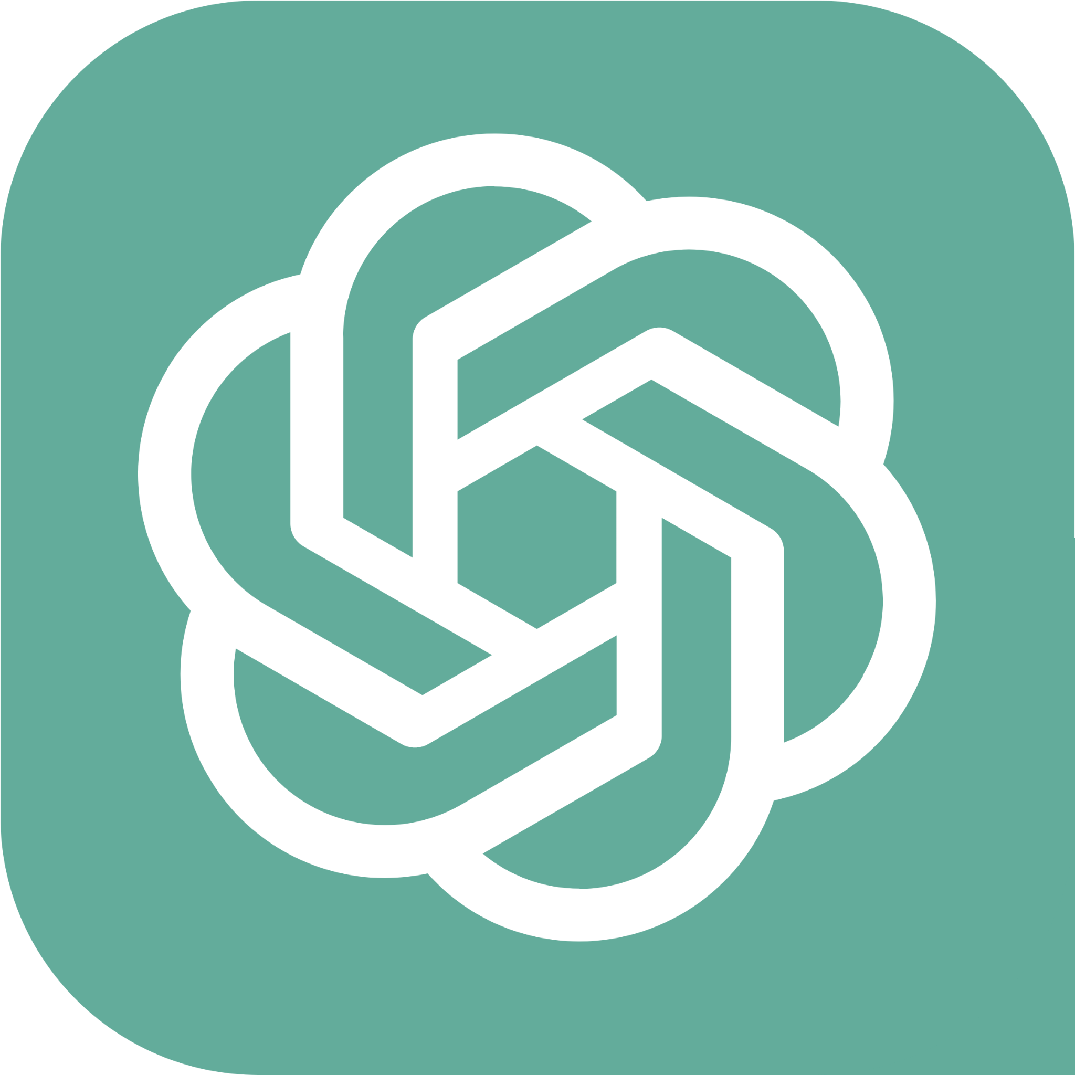




What is NLP?
Examples from Daily Life:
Chatbots
Language Translation
Virtual Assistants
Email Classification
Search Engines
Recruitment

Slide 25
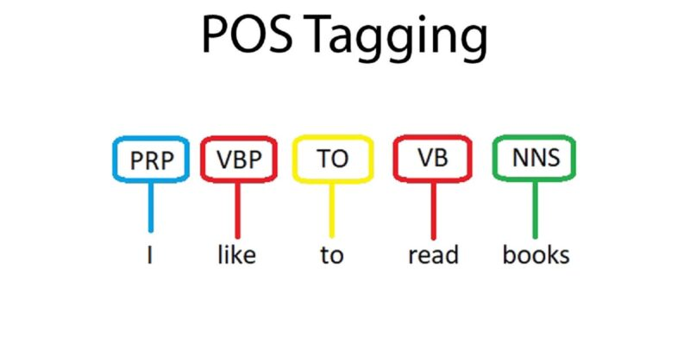
Applications of NLP
POS Tagging: is the process of marking up a word in a text as corresponding to a particular part of speech, based on both its definition and its context.

Slide 26
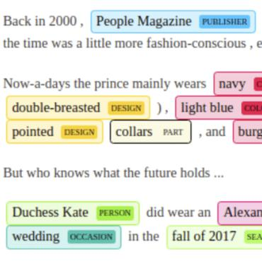
Applications of NLP
2. Named Entity Recognition: the task of identifying and categorizing key information (entities) in text

Slide 27
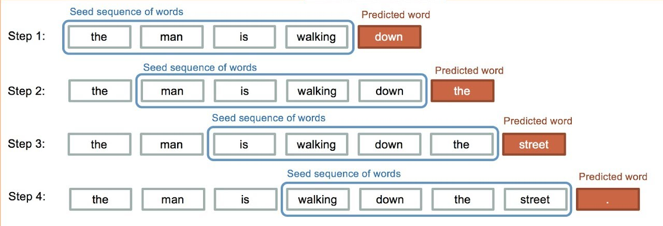
Applications of NLP
3. Text Generation

Slide 28
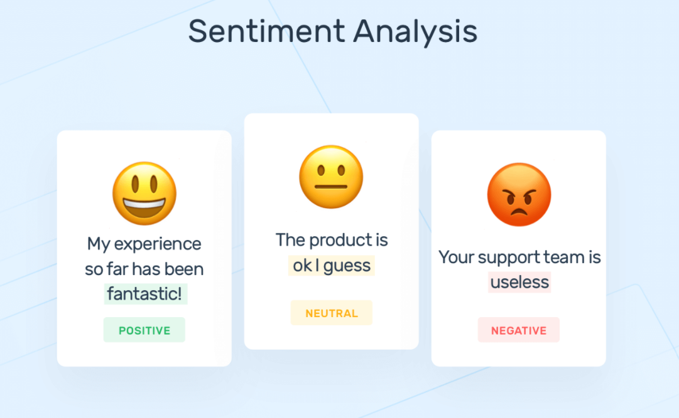
Applications of NLP
4. Sentiment Analysis

Slide 29
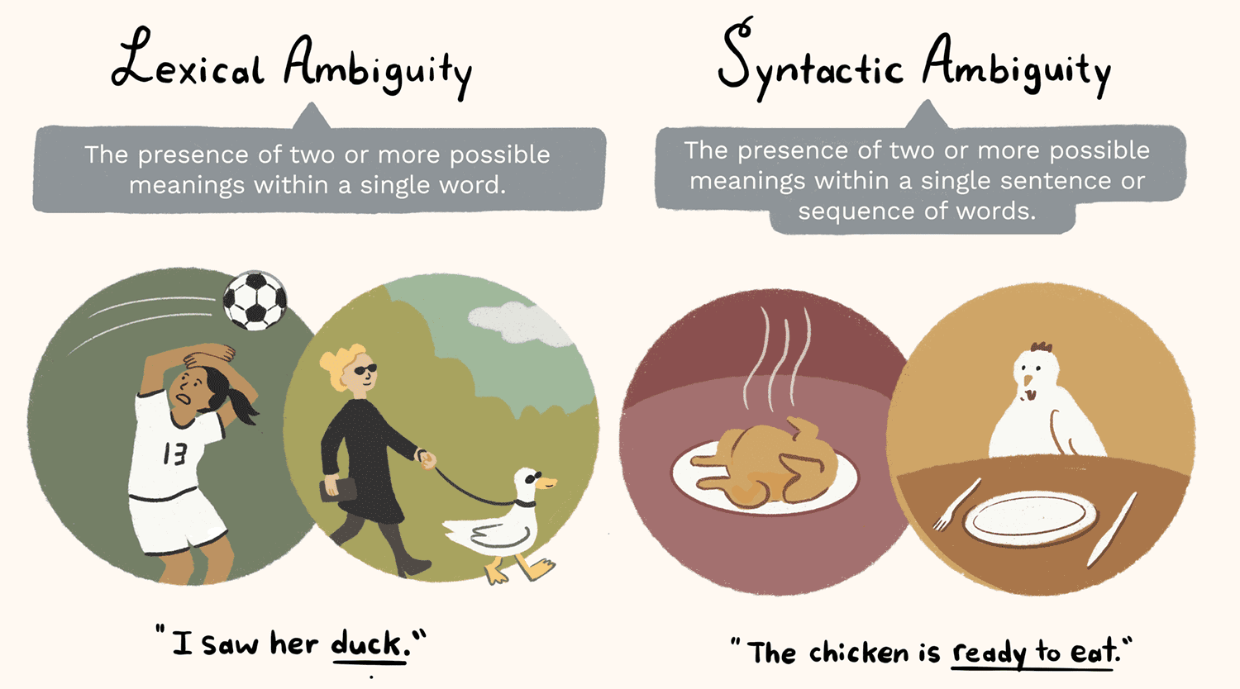
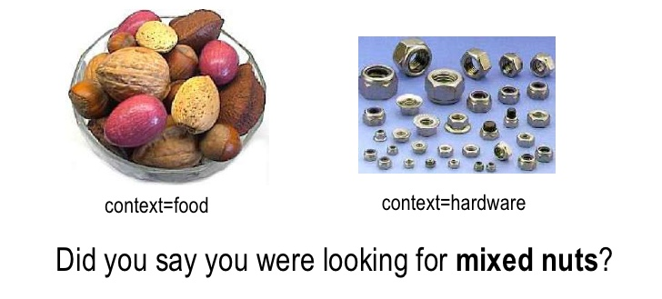
Challenges of NLP: Ambiguity
Lexical Ambiguity: Multiple meanings for one word
Syntactic Ambiguity: Multiple meanings for part of a sentence
Semantic Ambiguity: Multiple meanings for the whole sentence
Anaphoric Ambiguity: Pronouns and demonstratives might have multiple meanings.

Slide 30
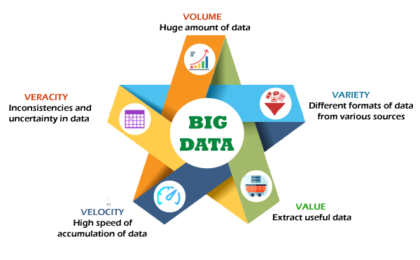
Challenges of NLP: Unclean Data

Slide 31
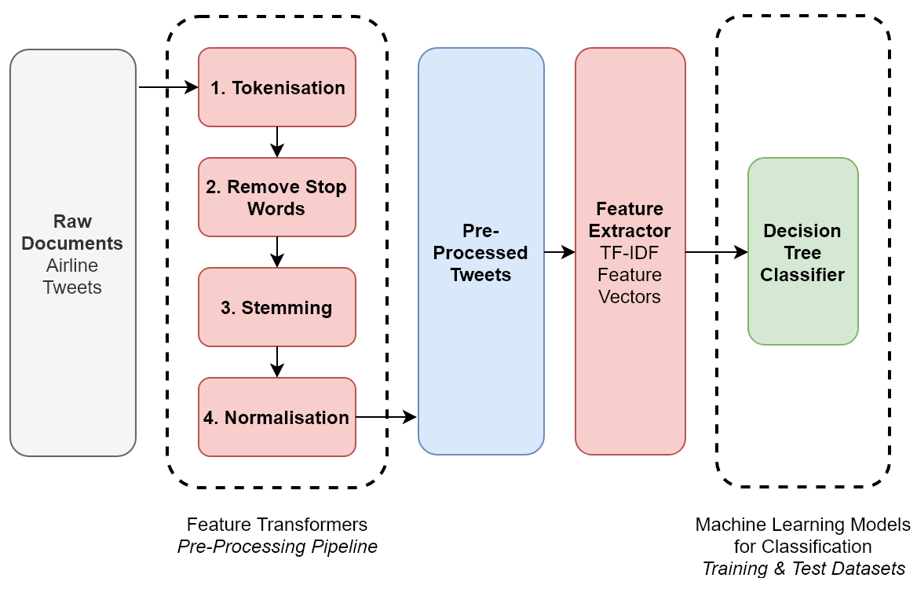
NLP Pipelines

Slide 32
Tokenization
Transforming text from one string to a string of words
NLP Data Pre-processing
Removing Stop Words
They add no unique information and might cause bias
Stemming
Transforming words to their base form
Normalization
Making sure the text is in one form

Slide 33
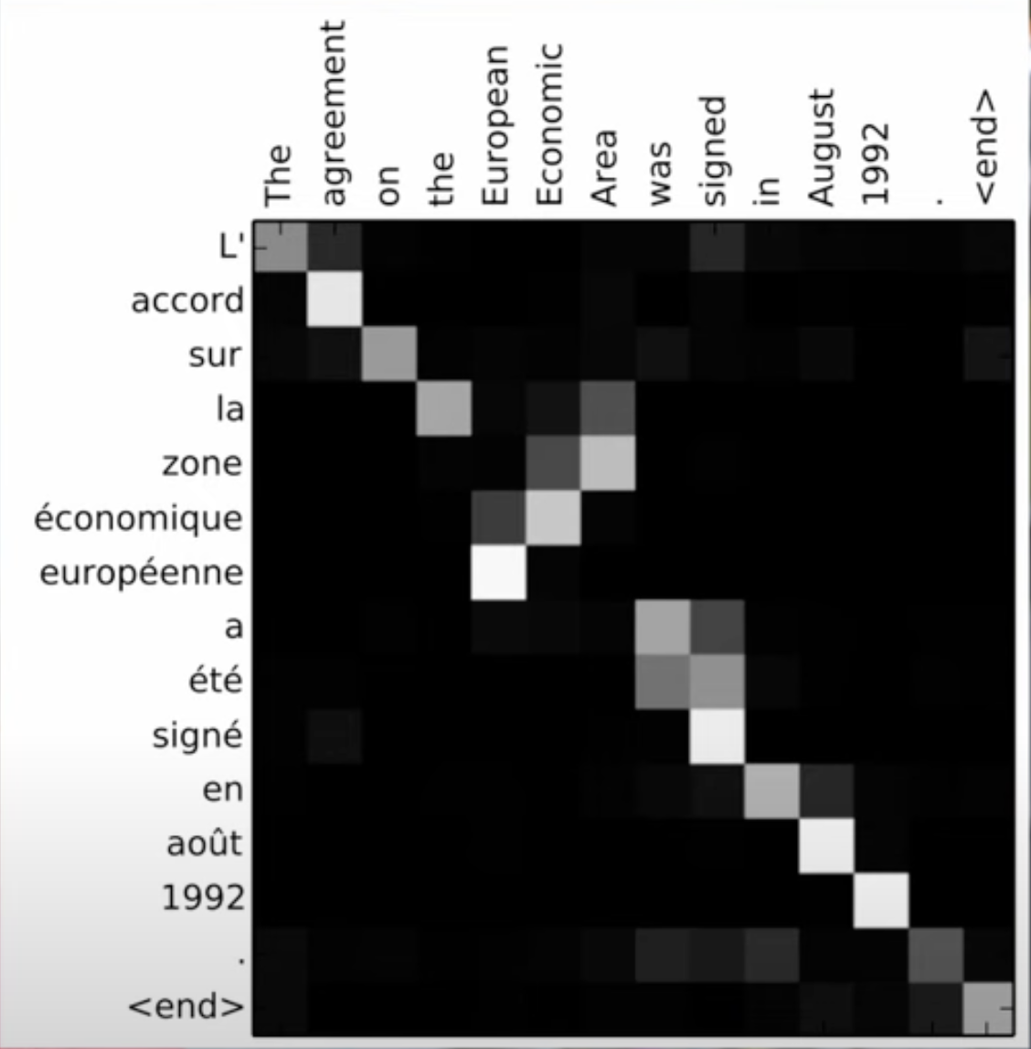
Transformers
Based on the concept of Attention (The ability of a model to pay attention to the important part of the sentence), a novel architecture that aims to solve sequence-to-sequence tasks while handling long-range dependencies with ease.

Slide 34
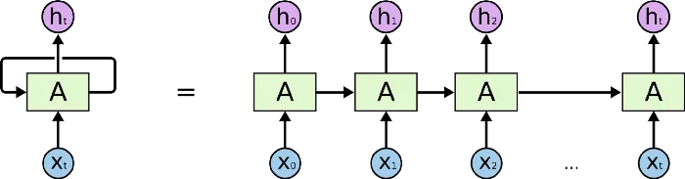
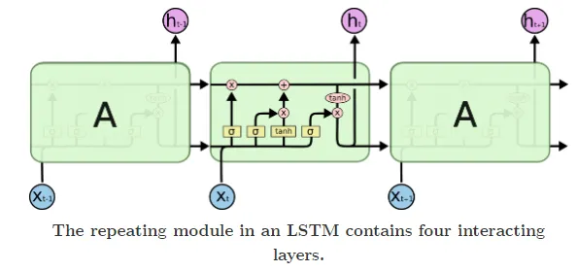
RNN vs LSTM vs Transformers

Slide 35
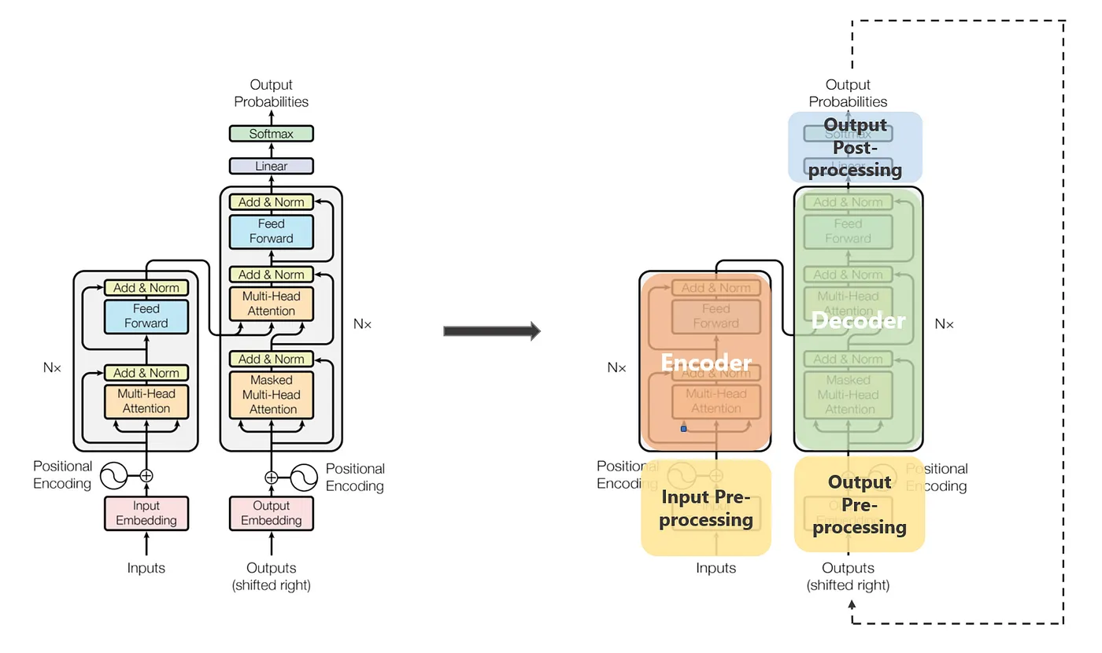

Slide 36
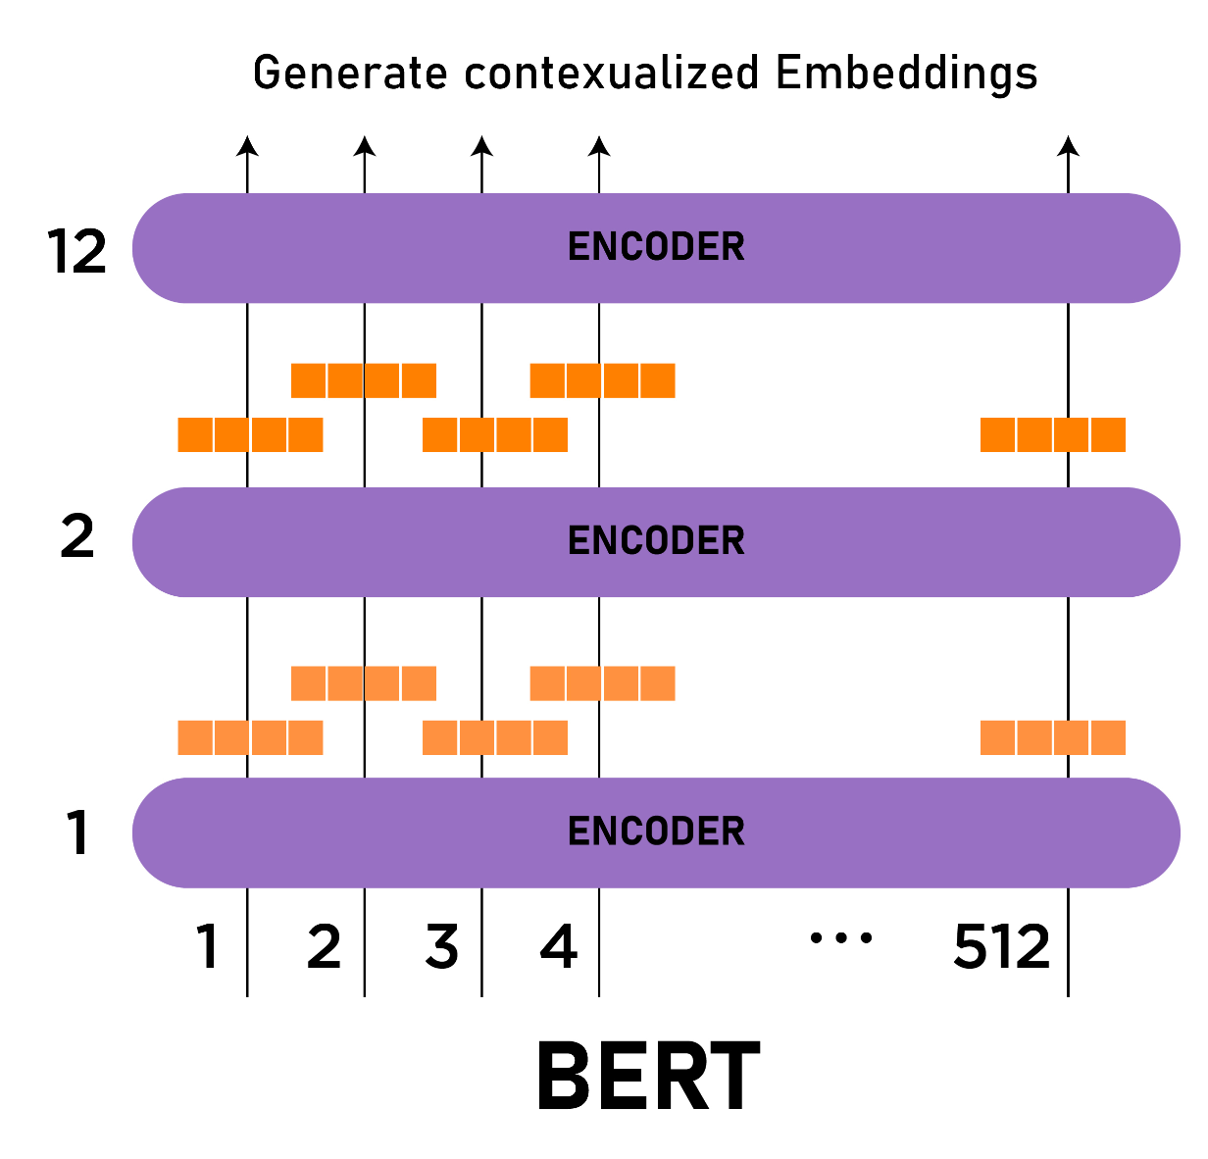
BERT
Bidirectional Encoder Representations from Transformers: is a language model based on the Transformers Architecture.
Consists of two parts:
Masked Language Model
Specific Task Model

Slide 37
Break
Grab a coffee & get ready to build your Sentiment Analysis model with BERT

Slide 38


Thank You!
BeirutAI
BeirutAI
BeirutAI
Contact us:
76-855988
beirut.ai
workshops@beirutai.org
beirutai.org

Slide 39
BDD Events
Event$@BDD23#

